Slide 1


Slide 2

Notes:
Two models with the same accuracy behave very differently in deployment. Why? Distribution shift and variance: Because accuracy is an average, while deployment exposes models to changing data distributions and different levels of variance.

Slide 3
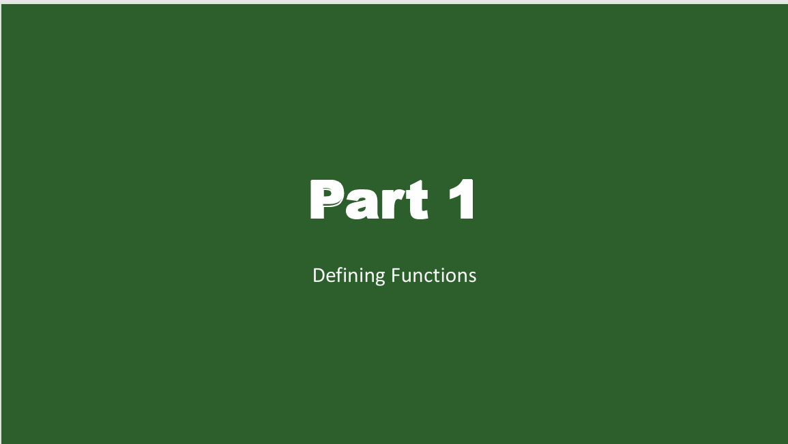
Notes:
Two models with the same accuracy behave very differently in deployment. Why? Distribution shift and variance: Because accuracy is an average, while deployment exposes models to changing data distributions and different levels of variance.

Slide 4
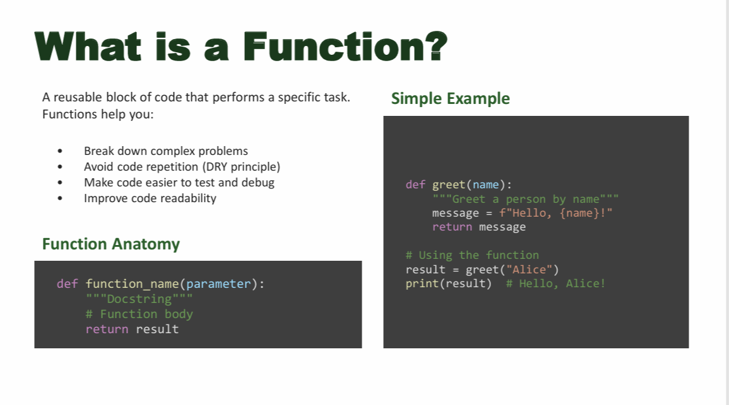
Notes:
Two models with the same accuracy behave very differently in deployment. Why? Distribution shift and variance: Because accuracy is an average, while deployment exposes models to changing data distributions and different levels of variance.

Slide 5
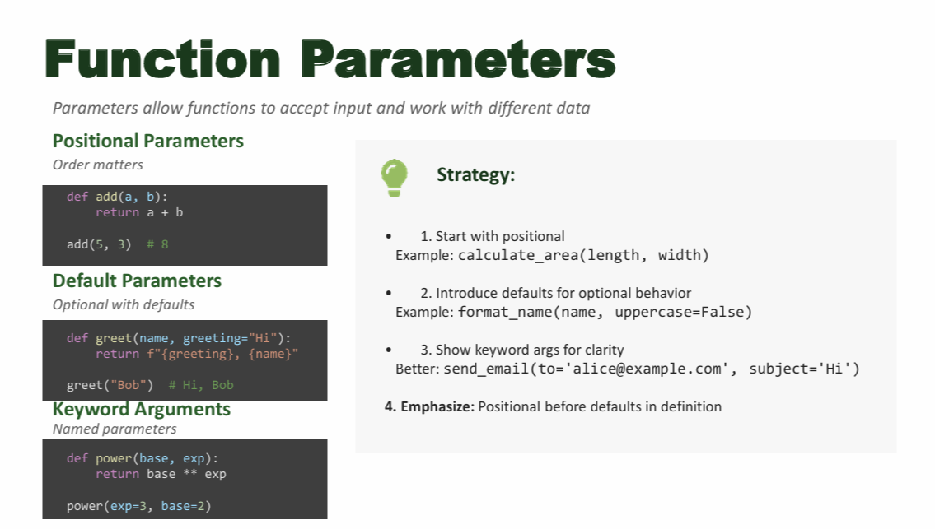
Notes:
Two models with the same accuracy behave very differently in deployment. Why? Distribution shift and variance: Because accuracy is an average, while deployment exposes models to changing data distributions and different levels of variance.

Slide 6
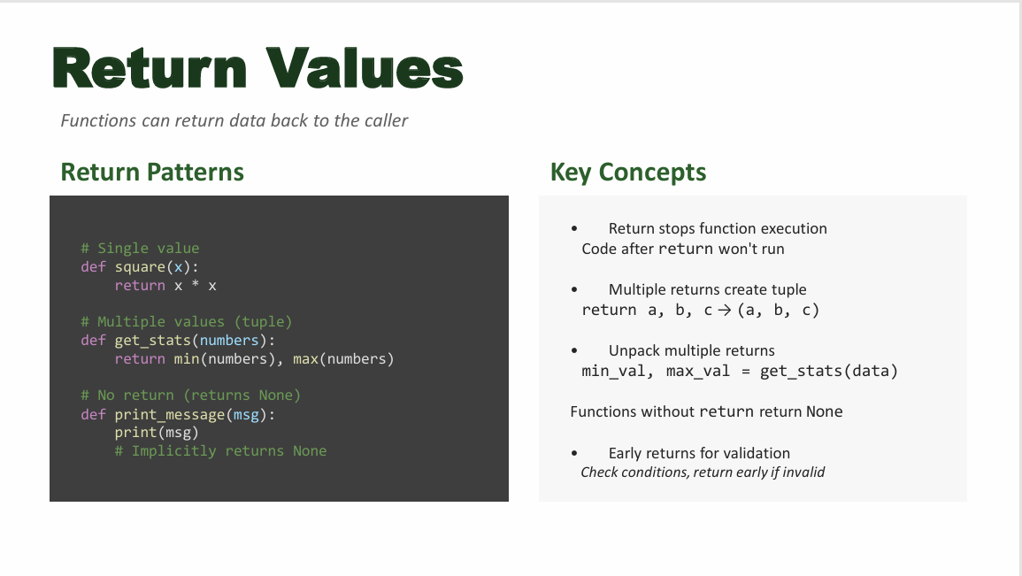
Notes:
Two models with the same accuracy behave very differently in deployment. Why? Distribution shift and variance: Because accuracy is an average, while deployment exposes models to changing data distributions and different levels of variance.

Slide 7

Notes:
Two models with the same accuracy behave very differently in deployment. Why? Distribution shift and variance: Because accuracy is an average, while deployment exposes models to changing data distributions and different levels of variance.

Slide 8
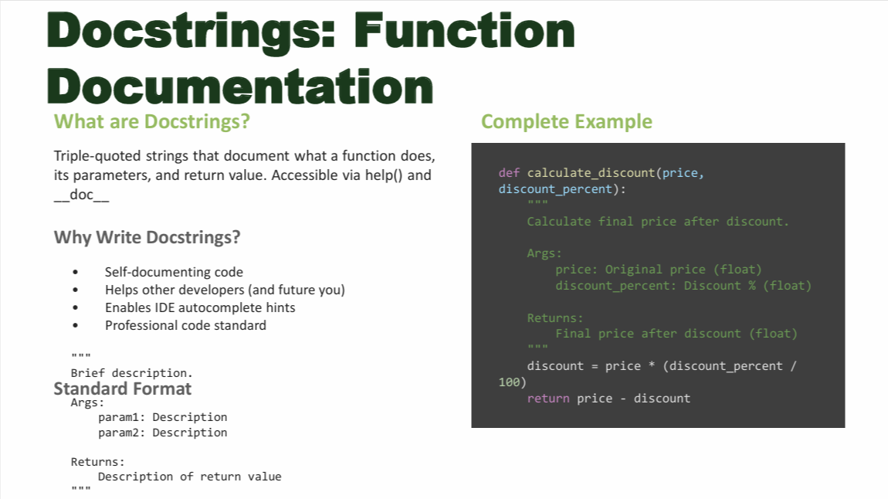
Notes:
Two models with the same accuracy behave very differently in deployment. Why? Distribution shift and variance: Because accuracy is an average, while deployment exposes models to changing data distributions and different levels of variance.

Slide 9

Notes:
Two models with the same accuracy behave very differently in deployment. Why? Distribution shift and variance: Because accuracy is an average, while deployment exposes models to changing data distributions and different levels of variance.

Slide 10
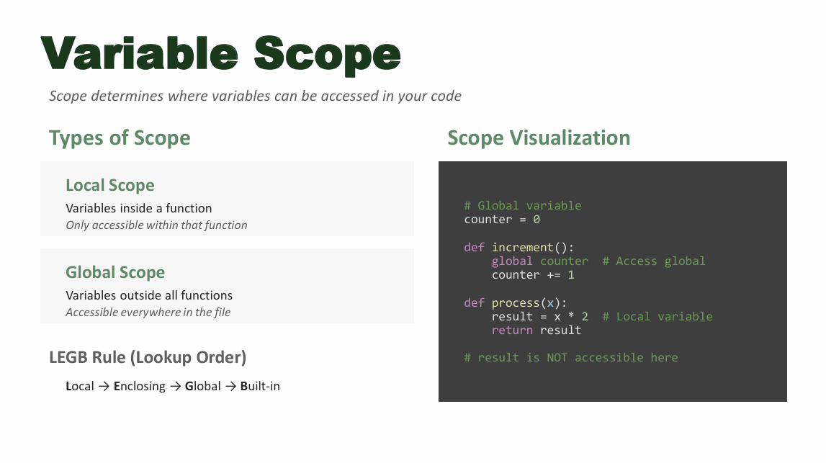

Slide 11
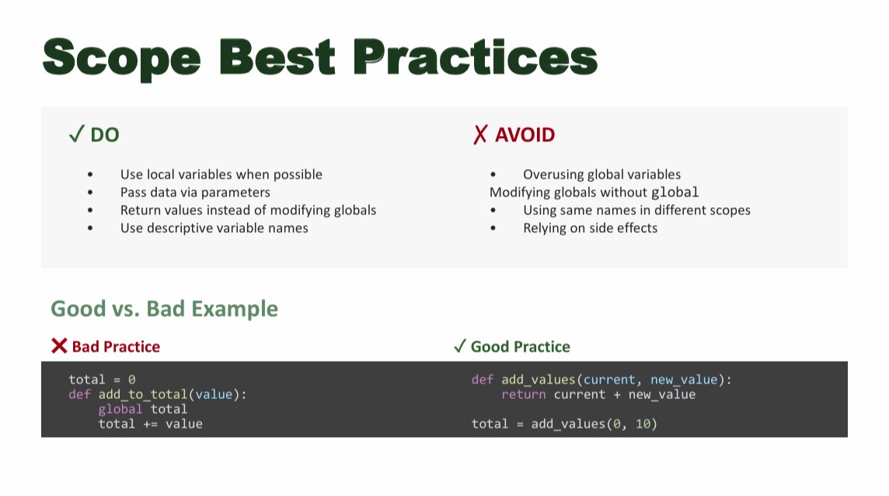

Slide 13
